Slide 1
MoTOR CONTROL USING GSM MODULE

Slide 2
GSM Based Water Pump Control
INTRODUCTION:-
• The main aim of this project is to turn on and off water pump from anywhere using mobile phone.
• Now a day’s most of the farmers use water from the wells and underground water resources for their farms. And for this they need water pumps.
• Using Arduino and GSM Shield we are implementing this project.
• The purpose of this is to help the farmer to turn on or turn off the motor. By using this farmer is able to operate the motor from anywhere using mobile phone.

Slide 3
Software rEQUIREMENTS :-Arduino ide Language used:- Arduino ide

Slide 4
Hardware requirement
Arduino Uno r3
GSM Shield

Slide 5
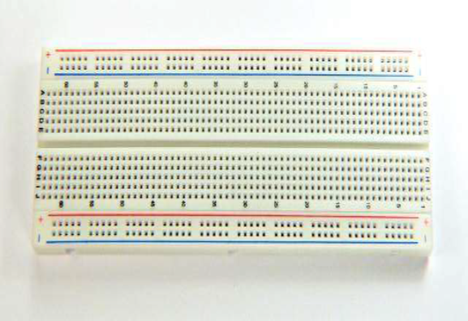
Bread Board
Jumper wires

Slide 6
Arduino Uno

Slide 7
• Arduino: an open source computer hardware and software company, project, and user community that designs and manufactures single-board microcontrollers and microcontroller kits for buildingdigital devices and interactive objects that can senseand control objects in the physical world. • Arduino board designs use a variety of microprocessorsand controllers. The boards are equipped with sets ofdigital and analog input/output (I/O) pins that may beinterfaced to various expansion boards (shields) andother circuits.

Slide 8
Features of the Arduino UNO r3:
• Microcontroller: ATmega328
• Operating Voltage: 5V
• Input Voltage (recommended): 7-12V
• Input Voltage (limits): 6-20V
• Digital I/O Pins: 14 (of which 6 provide PWM output)
• Analog Input Pins: 6
• DC Current per I/O Pin: 40 mA
• DC Current for 3.3V Pin: 50 mA
• Flash Memory: 32 KB of which 0.5 KB used by bootloader
• SRAM: 2 KB (ATmega328)
• EEPROM: 1 KB (ATmega328)
• Clock Speed: 16 MHz

Slide 9
GSM Shield sim900A

Slide 10
Specifications: GSM SIM900A USB SHIELD
• GSM/GPRS Module: SIMCOM SIM900A
• On board Interfaces
• USB (usb to serial using CP2102)
• RS232 with MAX232
• TTL pin breakout (RX,TX,GND)

Slide 11
General Feature
• Dual-Band 900/ 1800 MHz
•GPRS multi-slot class 10/8
•GPRS mobile station class B
•Compliant to GSM phase 2/2+
– Class 4 (2 W @900 MHz)
– Class 1 (1 W @ 1800MHz)
•SAIC (Single Antenna Interference Cancellation) support
•Dimensions: 24* 24 * 3 mm
•Weight: 3.4g
•Control via AT commands (GSM 07.07 ,07.05 and SIMCOM enhanced AT Commands)
•SIM application toolkit
•Supply voltage range : 3.2 ... 4.8V
•Low power consumption: 1.0mA(sleep mode&BS -PAMFRMS=9 )
•Operation temperature: -40°C to +85 °C

Slide 13
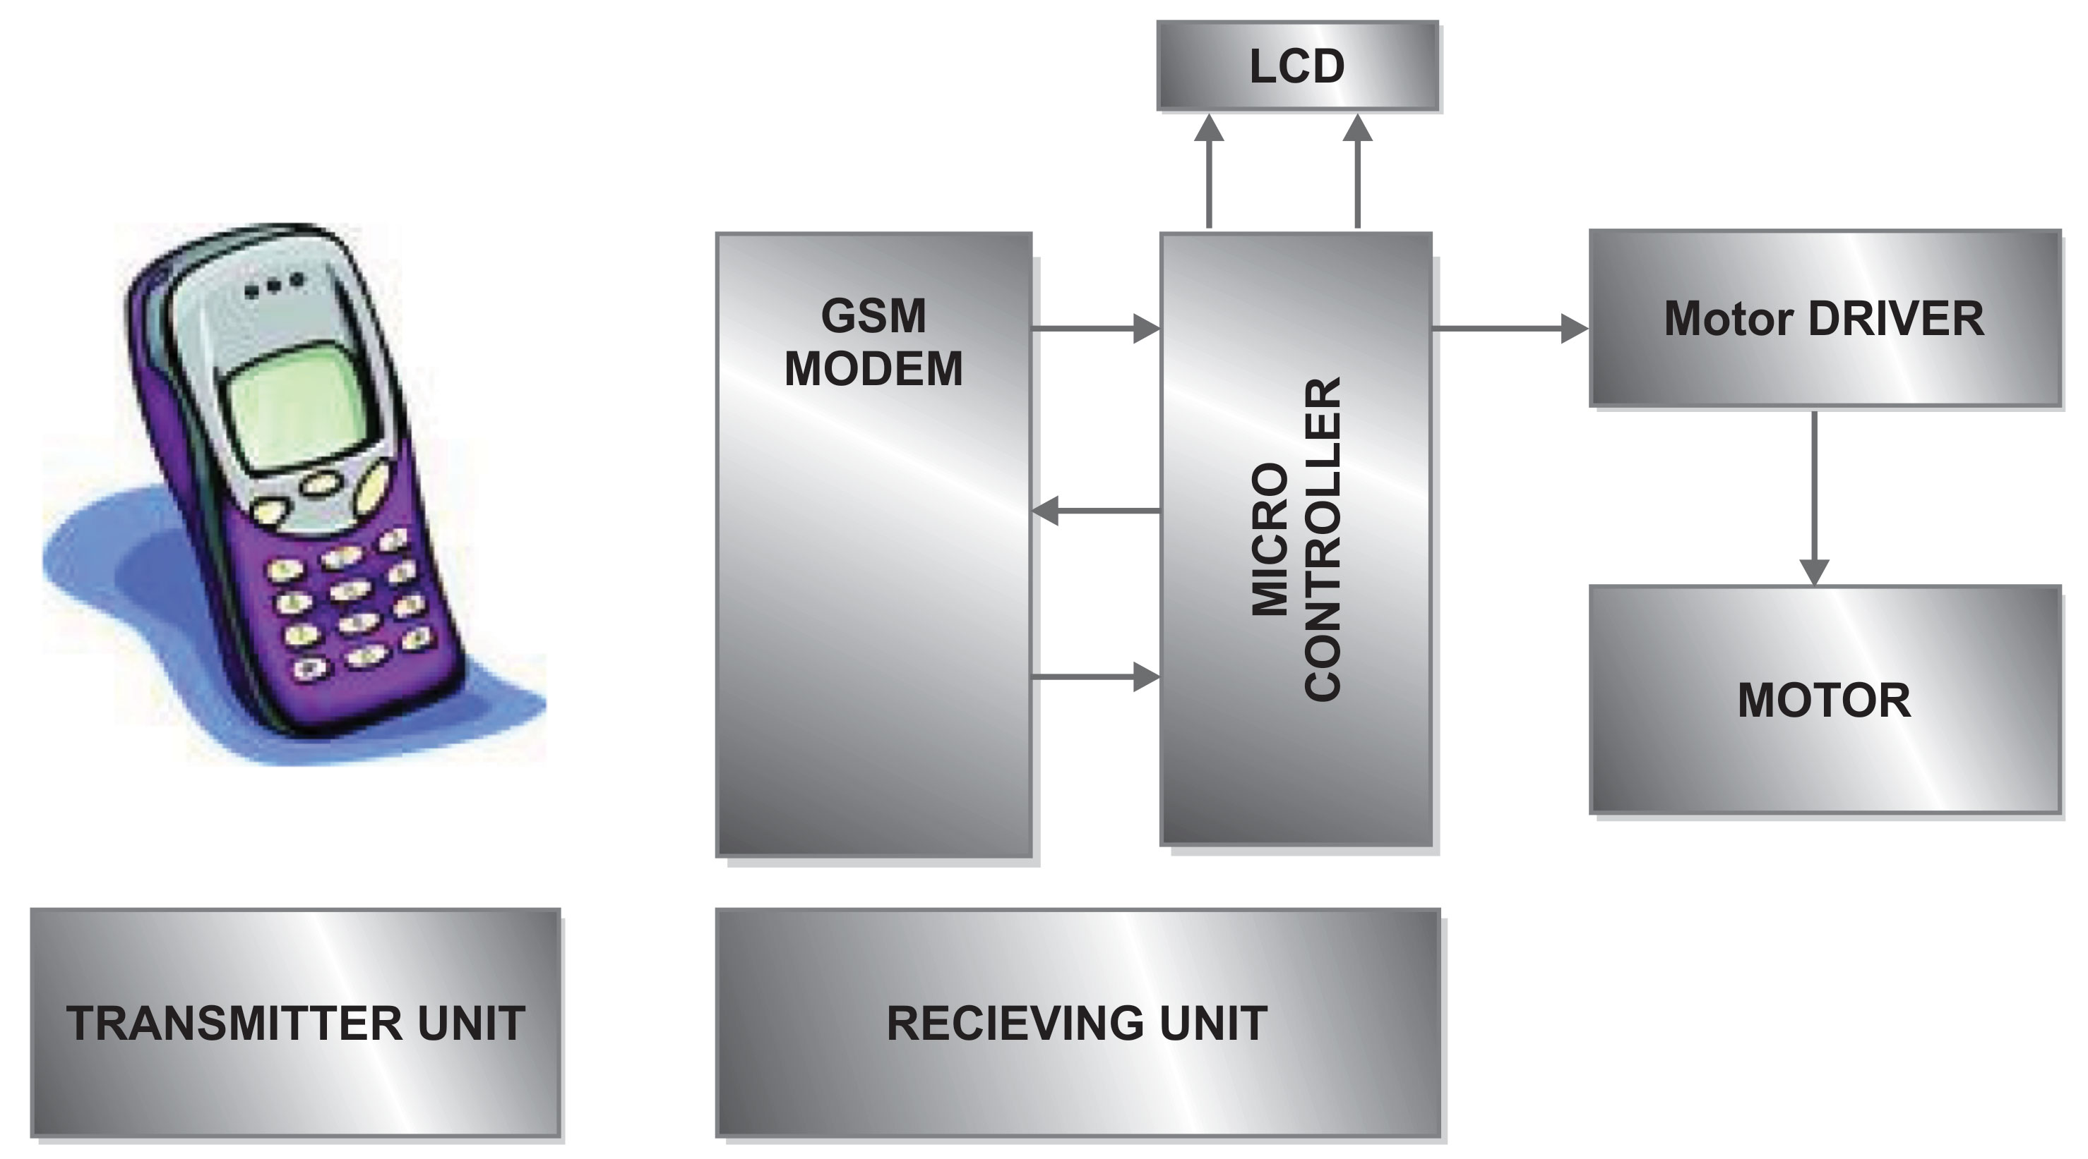
BLOCK DIAGRAM

Slide 14
Future Scope :-
• Instead of going to fields.We can Control motor using sms to on/off the motors.
Using this technology we can automize without internet
• Instead of switching of the water pump when single phase is present , convert the single phase power supply to three phase power supply.

Slide 15
THANKING YOU

